Slide 1
Agent-Based Modelling
Wolf Sheep Predation

Slide 2
Outline
What is this model about
How it works
Extending the model

Slide 3
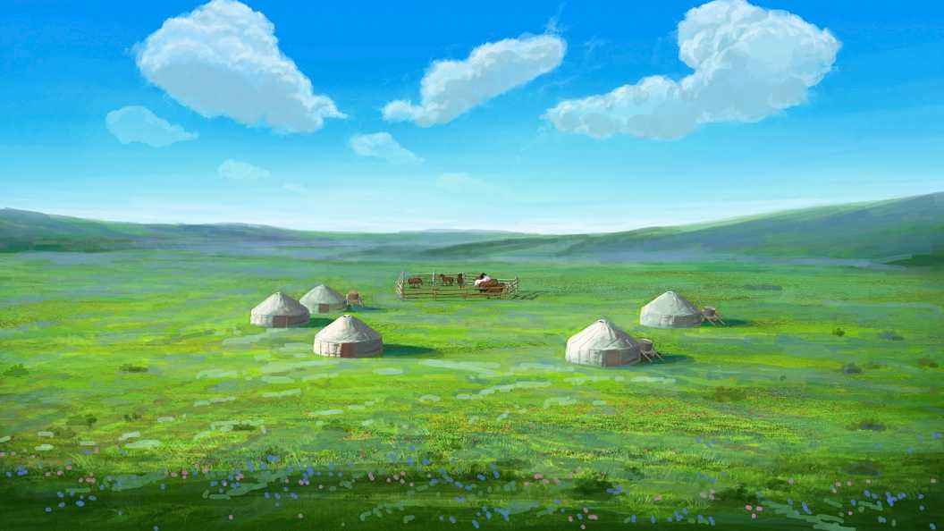
Imagine there is a prairie…
Notes:
This model explores the stability of predator-prey ecosystems. Such a system is called unstable if it tends to result in extinction for one or more species involved. In contrast, a system is stable if it tends to maintain itself over time, despite fluctuations in population sizes

Slide 4
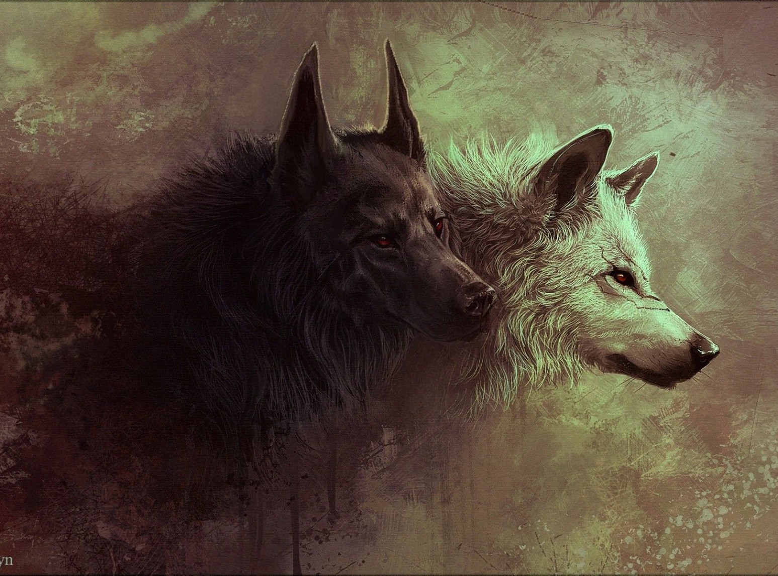
Variations In The Model
Wolves and sheep wander randomly around the landscape.
Each step costs the wolves energy, and they must eat sheep in order to replenish their energy - when they run out of energy they die.
Fixed probability of reproducing at each time step.

Slide 5
Variations In The Model
Sheep must eat grass in order to maintain their energy - when they run out of energy they die.
Once grass is eaten it will only regrow after a fixed amount of time.
Notes:
The second variation includes grass (green) in addition to wolves and sheep. The behavior of the wolves is identical to the first variation, however this time the sheep must eat grass in order to maintain their energy - when they run out of energy they die. Once grass is eaten it will only regrow after a fixed amount of time. This variation is more complex than the first, but it is generally stable.
The construction of this model is described in two papers by Wilensky & Reisman referenced below.

Slide 6



Meadow
Sheep
Wolf

Slide 7
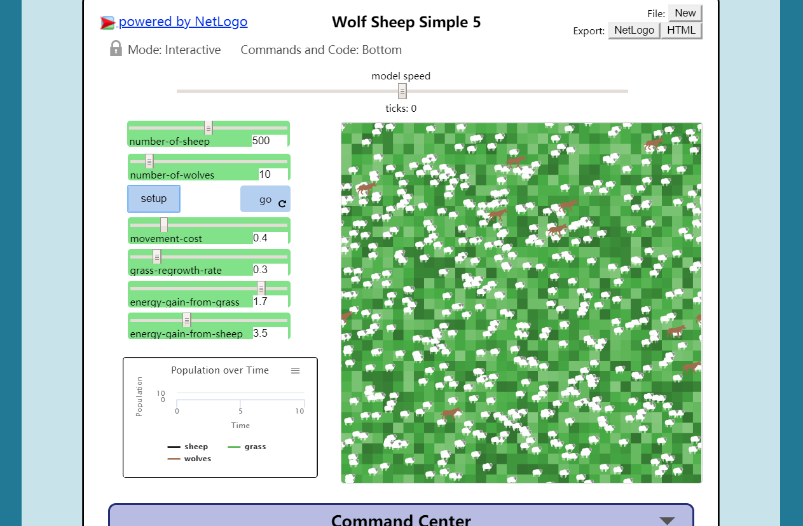
User Interface: changeable variables
Number of sheep
Number of wolves
Movement cost
Grass regrowth rate
Energy gain from grass
Energy gain from sheep

Slide 8
Unchangeable variables
Moving speed of sheep and wolves
Rate of reproduction
Energy cost of reproduction

Slide 9
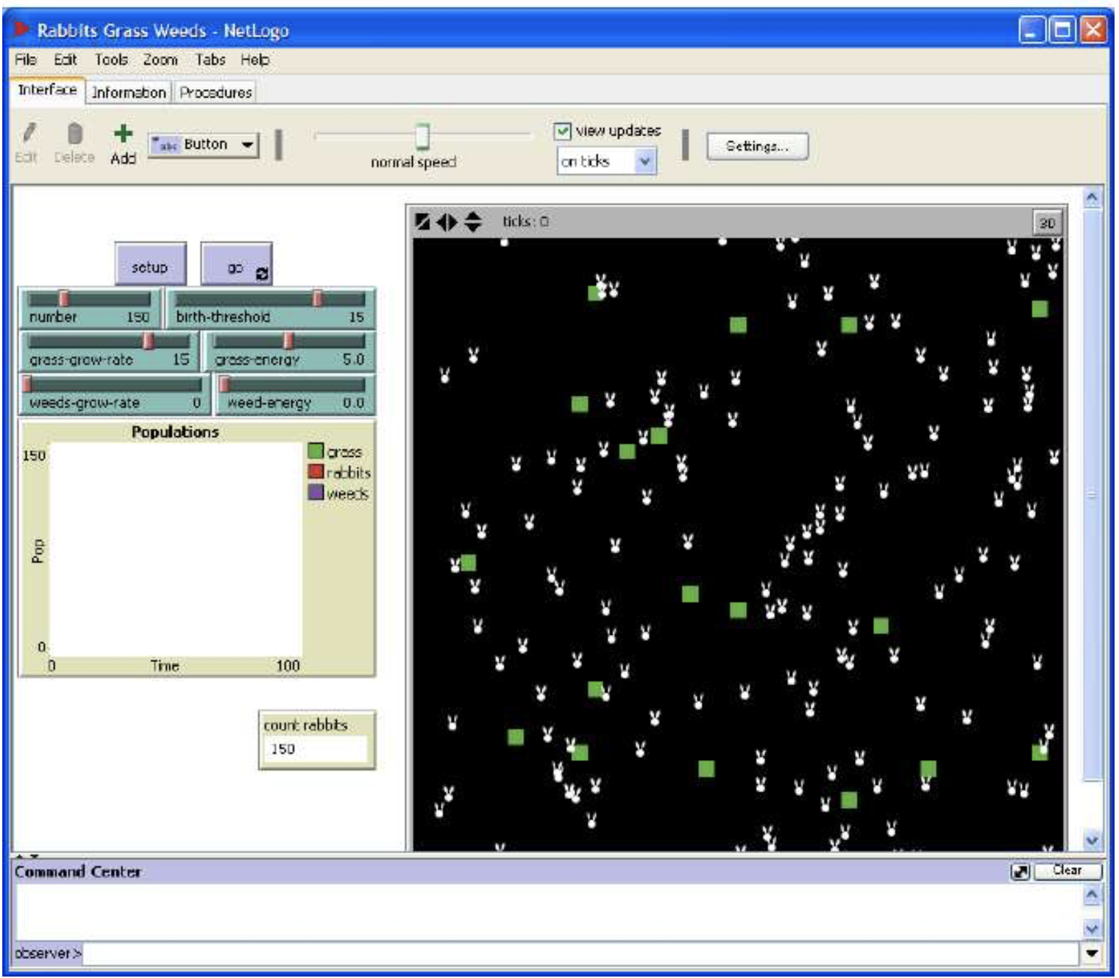
Extending the model
Rabbits Grass Weeds
Notes:
There are a number ways to alter the model so that it will be stable with only wolves and sheep (no grass). Some will require new elements to be coded in or existing behaviors to be changed. Can you develop such a version?
Rabbits grass model

Slide 10
Thank You

